Slide 1
SHOULDER REGOIN AND JOINTS
BY
Dr. F.O. OPOOLA

Slide 2
OBJECTIVES
List the name of muscles of the shoulder region.
Describe the anatomy of muscles of shoulder region:
attachments of each of them to scapula & humerus
nerve supply and actions on shoulder joint.
List the muscles forming the rotator cuff and describe the relation of each of them to the shoulder joint.
Describe the anatomy of shoulder joint regarding: type, articular surfaces, stability, relations & movements.

Slide 3
INTRODUCTION
The shoulder is a complex combination of bones and joints where many muscles act to provide the widest range of motion of any part of the body.
Numerous muscles help stabilize the three joints of the shoulder while giving it motion
Bones of the shoulder:
• Clavicle
• Scapula
• Humerus

Slide 4
BONES OF THE SHOULDER
Clavicle: Also known as the collarbone, the clavicle extends across the front of the shoulder from the sternum to the scapula. It helps stabilize the shoulder’s movements.
Scapula: More commonly known as the shoulder blade, the scapula is a flat triangular bone located in the upper back. It connects with the collarbone at the front of the body.
Humerus: The largest bone of the arm, the humerus connects to the scapula and clavicle in the shoulder. The head of the bone has a ball-like knob to create a ball-and-socket joint with the scapula.

Slide 5
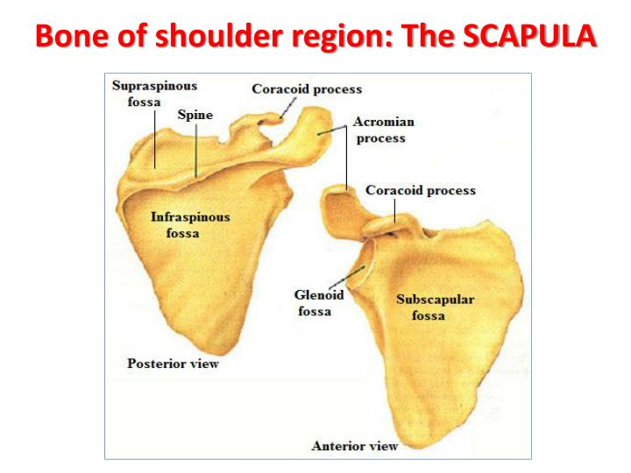

Slide 6
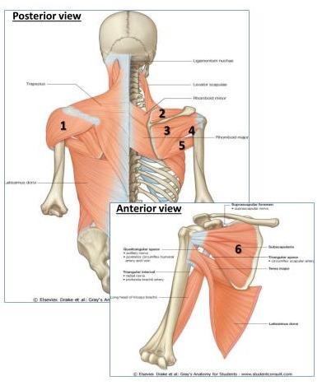
MUSCLES OF SHOULDER REGION
These muscles connect scapula to humerus (move humerus through shoulder joint)
Deltoid
Supraspinatus
Infraspinatus
Teres minor
Teres major
Subscapularis

Slide 7
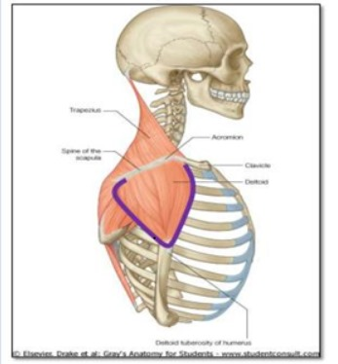
DELTOID
A triangular muscle forms the contour of the shoulder.
Origin: Lateral 1/3 of clavicle + acromion and spine of scapula
Insertion: Deltoid tuberosity of humerus
Nerve Supply: Axillary nerve
Actions:
Anterior fibers: flexion and medial rotation of humerus(arm, shoulder joint)
Middle fiber : abduction of humerus from 15º – 90^{O} .
Posterior Fibres: extention & lateral rotation of humerus.

Slide 8
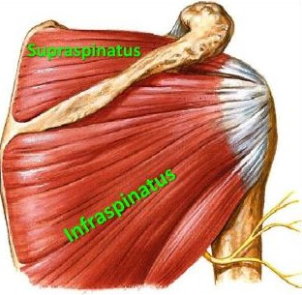
SUPRASPNATUS & INFRASPINATUS
ORIGIN
1. Supraspinatus: Supraspinous fossa.
2. Infraspinatus: Infraspinous fossa.
Insertion: greater tuberosity of humerus
Nerve supply: suprascapular nerve
Action:
Supraspinatus: abduction of humerus from 0⁰ – 15⁰
Infraspinatus: lateral rotation of humerus

Slide 9
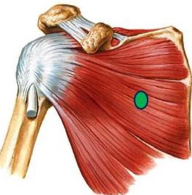
SUBSCAPULARIS
Insertion: lesser tuberosity of humerus
Nerve supply: upper & lower subscapular nerves
Action: medial rotation of humerus

Slide 10
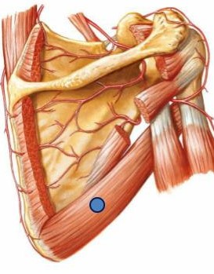
TERES MAJOR
ORIGIN
Lateral border of scapula
Insertion: bicipital groove of humerus (look to insertion of latissimus dorsi & pectoralis major).
Nerve supply: lower subscapular nerve.
Actions: extension, adduction & medial rotation of humerus (look to action of latissimus dorsi)

Slide 11
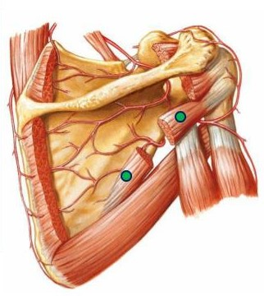
TERES MINOR
ORIGIN
Lateral border of scapula
Insertion: greater tuberosity of humerus
Nerve supply: axillary nerve
Actions: lateral rotation of humerus

Slide 12
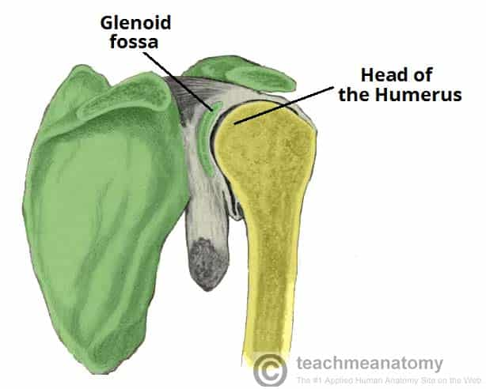
SHOULDER JOINTS
The shoulder joint is formed by an articulation between the head of the humerus and the glenoid cavity (or fossa) of the scapula. This gives rise to the alternate name for the shoulder joint – the glenohumeral joint.
Like most synovial joints, the articulating surfaces are covered with hyaline cartilage.
The head of the humerus is much larger than the glenoid fossa, giving the joint a wide range of movement at the cost of instability. To reduce the disproportion in surfaces, the glenoid fossa is deepened by a fibrocartilage rim – called the glenoid labrum

Slide 13
SHOULDER JOINTS
The junctions of these three bones and the sternum (chest bone) form three joints:
Glenohumeral joint: This shallow ball-and-socket-style joint created by the humerus and scapula allows the arm to rotate circularly and to move up and out from the body. It is surrounded by soft tissue and strengthened by fibrous ligaments.
Acromioclavicular (AC) joint: This joint forms the highest point of the shoulder and provides the ability to raise the arm above the head. The meeting of the scapula and clavicle forms it.
Sternoclavicular joint: This joint is at the center of the chest where the clavicle meets the sternum. It allows the clavicles to move.

Slide 14
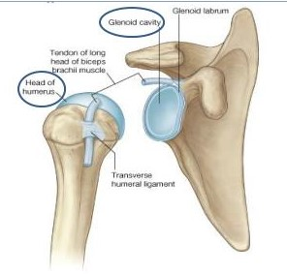
SHOULDER (Glenohumeral) JOINT
TYPE: Synovial, multiaxial, ball & socket
ARTICULAR SURFACES:
Head of humerus
Glenoid cavity (fossa) of scapula
Covered with hyaline cartilage

Slide 15
SHOULDER JOINTS
Each joint is surrounded by:
cartilage, to pad the meetings of the bones;
ligaments, to connect the bones;
muscles; and
  tendons, to attach the muscles to the bones.
The collection of muscles and tendons in the shoulder is known as the rotator cuff. It stabilizes the shoulder and holds the head of the humerus in the glenoid, a shallow cavity in the scapula. The muscles of the rotator cuff include the supraspinatus, infraspinatus, teres minor, and subscapularis.

Slide 16
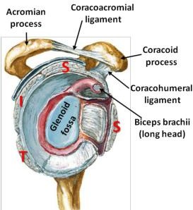
ROTATOR CUFF
A tendinous cuff around the shoulder joint covering its anterior, posterior and superior aspects.
The cuff is deficient inferiorly and this is the site of potential weakness of the joint.
It is formed of 4 muscles: supraspinatus, infraspinatus, teres minor & subscapularis (SITS).
The tone of these muscles helps in stabilizing the shoulder joint.

Slide 17
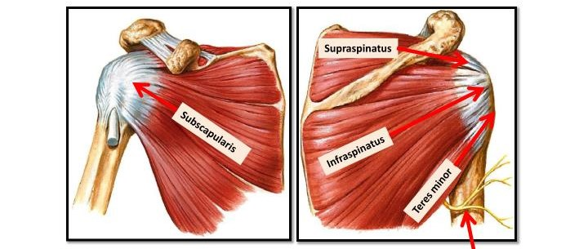
RELATIONS OF SHOULDER JOINT
axillary nerve
ANTERIOR: subscapularis
POSTERIOR: infraspinatus, teres minor
SUPERIOR: supraspinatus
INFERIOR: axillary nerve

Slide 18
MOVEMENTS OF SHOULDER JOINT
FLEXION:
Anterior fibers of deltoid
Pectoralis major
Coracobrachialis (muscle of arm)
Short head of biceps brachii (muscle of arm)
EXTENSION:
Posterior fibers of deltoid
Latissimus dorsi
Teres major
ABDUCTION:
From 0º – 15º: Supraspinatus
From 15º – 90º: Middle fibers of deltoid
ADDUCTION:
Pectoralis major
Latissimus dorsi
Teres major

Slide 19
SUMMARY
Shoulder joint:
Types: synovial, ball & socket
Articular surfaces: head of humerus & scapula
Stability: depends on rotator cuff
Relations: rotator cuff and axillary nerve
Movement: flexion, extension, abduction, adduction, medial & lateral rotation

